Slide 1
Interprocess Communications

Slide 2
Introduction
N/W Programming: Interaction of two or more processes. Therefore it is better to know different methods for process communication.
Single process: Interaction between different modules.
-- Global variables, functions.
There are two fundamentally different approaches in IPC:
- processes are residing on the same computer
- processes are residing on different computers
i.e Exchange of data between two or more separate, independent processes/threads.
Operating systems provide facilities/resources for inter-process communications (IPC), such as pipes,message queues, semaphores, and shared memory.

Slide 3
IPC Fundamentals
What is IPC?
Mechanisms to transfer data between processes
Why is it needed?
Not all important procedures can be easily built in a single process
Basic Concept:
- A sending process needs to communicate data to a receiving process
Sender wants to avoid details of receiver’s condition
Receiver wants to get the data in an organized way

Slide 4
IPC from the OS Point of View
OS address space
Private address space
Private address space
Process A
Process B

Slide 5
Fundamental IPC Problem for the OS
Each process has a private address space
Normally, no process can write to another process’s space
How to get important data from process A to process B?

Slide 6
OS Solutions to IPC Problem
Two options
1. Support some form of shared address space
Shared memory
2. Use OS mechanisms to transport data from one address space to another
Files, messages, pipes, RPC

Slide 7
IPC and Synchronization
Synchronization is a major concern for IPC
Allowing sender to indicate when data is transmitted
Allowing receiver to know when data is ready
Allowing both to know when more IPC is possible

Slide 8
Synchronizing in IPC
How do sending and receiving process synchronize their communications?
Many possibilities
Based on which process block when
Examples that follow in message context, but more generally applicable

Slide 9
Blocking Send, Blocking Receive
Both sender and receiver block
Sender blocks till receiver receives
Receiver blocks until sender sends

Slide 10
Non-Blocking Send, Blocking Receive
Sender issues send, can proceed without waiting to discover fate of message
Receiver waits for message arrival before proceeding
Essentially, receiver is message-driven

Slide 11
Non-Blocking Send, Non-Blocking Receive
Neither party blocks
Sender proceeds after sending message
Receiver works until message arrvies
Either receiver periodically checks in non-blocking fashion
Or some form of interrupt delivered

Slide 12
Typical UNIX IPC Mechanisms
Different versions of UNIX introduced different IPC mechanisms
Pipes
Message queues
Semaphores
Shared memory
Sockets
RPC

Slide 13
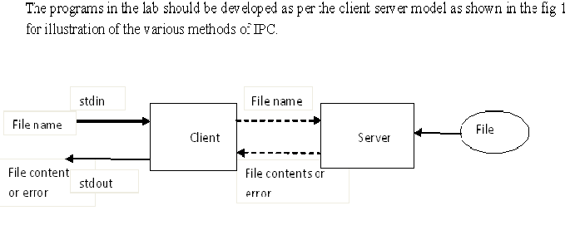

Slide 14
Pipes
Only IPC mechanism in early UNIX systems (other than files)
Uni-directional
Unformatted
Interprocess byte streams :
Accessed like files
i.e Anything can be written to the pipe, and read from the other end in the order it came in.
Only used for parent-child or sibling process pairs

Slide 15
Pipe Details
One process feeds bytes into pipe
A second process reads the bytes from it
Potentially blocking communication mechanism

Slide 16
Pipes and Blocking
Writing more bytes than pipe capacity blocks the sender
Until the receiver reads some of them
Reading bytes when none are available blocks the receiver
Until the sender writes some
Single pipe can’t cause deadlock

Slide 17

Pipe creation
int pipe(int fd[2]) -- creates a pipe and returns two file descriptors, fd[0], fd[1]
fd[0] is opened for reading, fd[1] for writing
pipe() returns 0 on success, -1 on failure and sets errno accordingly
The standard programming model is that after the pipe has been set up, two (or more) cooperative processes will be created by a fork and data will be passed using read() and write()
Pipes opened with pipe() should be closed with close(int fd )
Pipe has finite size 4096 bytes

Slide 18
Examples
Pipe in a single process
Pipes in two different processes
Usually unidirectional
Two pipes for duplex communication.
Command output can be piped. Eg: who|sort|lpr

Slide 19
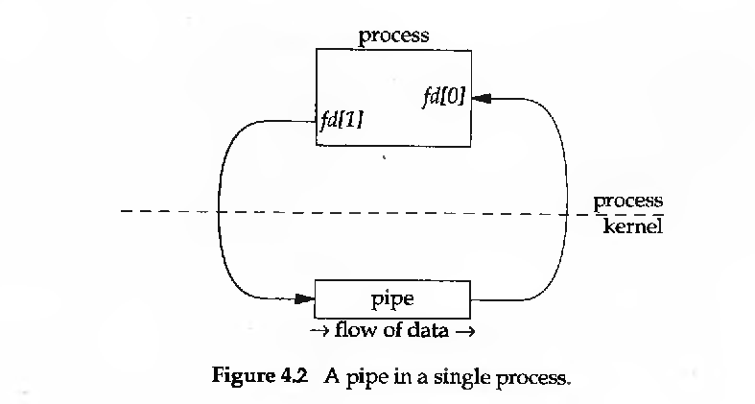

Slide 20
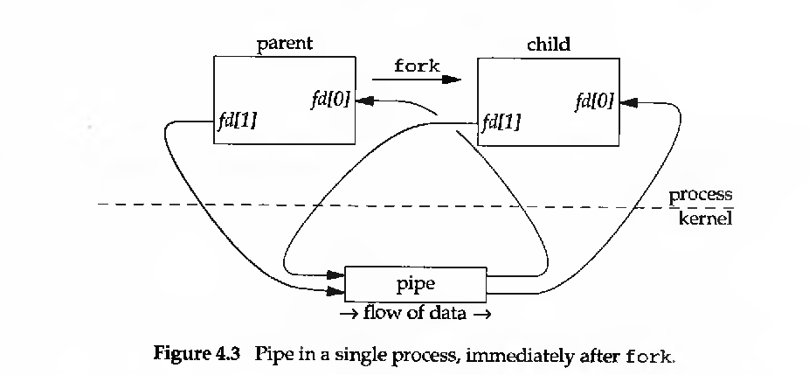

Slide 21
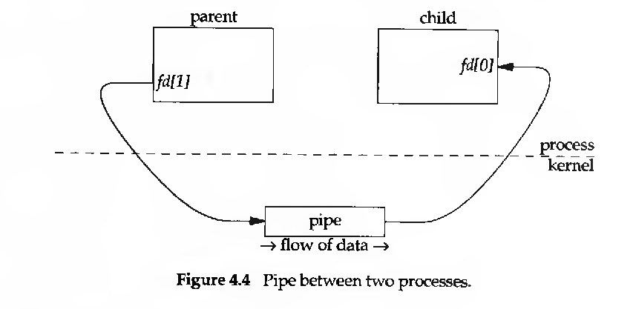

Slide 22
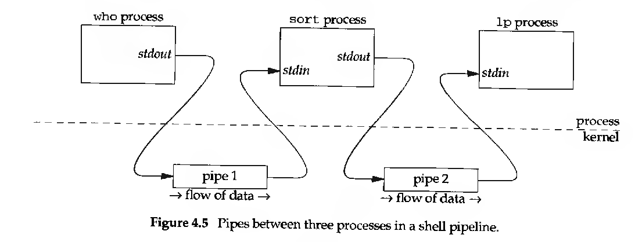

Slide 23
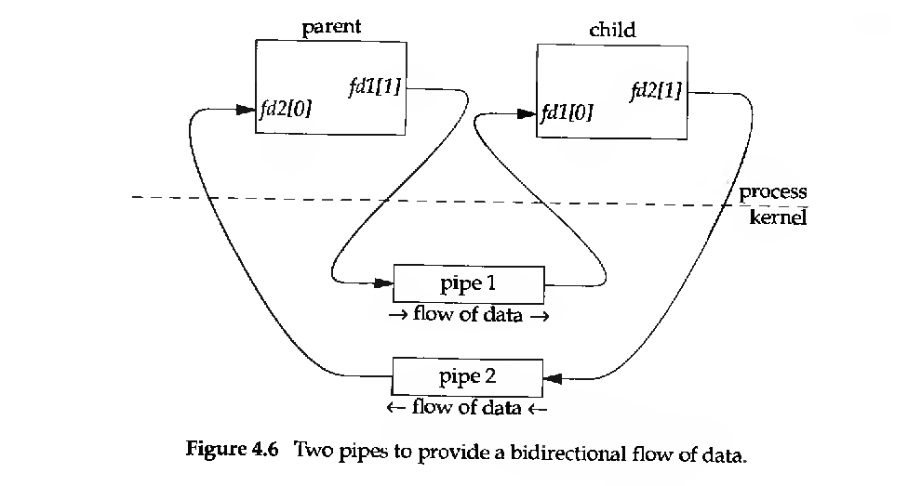
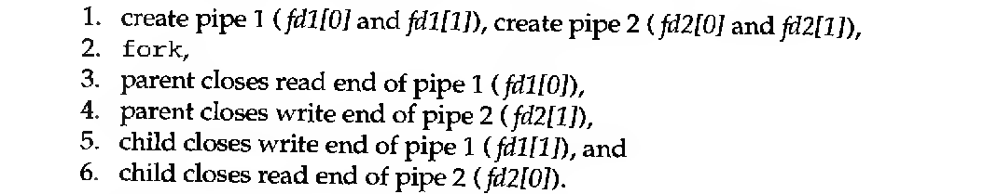

Slide 24
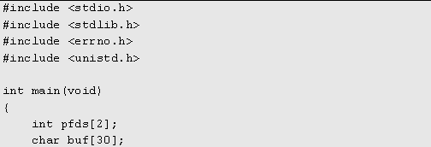
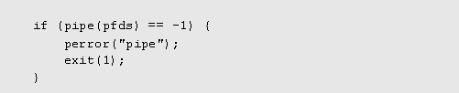
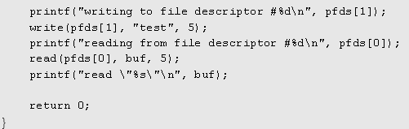
Pipe in a single process

Slide 25
Example: Parent writes to a child
int pdes[2];
pipe(pdes);
if ( fork() == 0 )
{ /* child */ close(pdes[1]); /* not required */ read( pdes[0]); /* read from parent */ .....
}
else
{ close(pdes[0]); /* not required */ write( pdes[1]); /* write to child */ .....
}

Slide 26
#include <unistd.h>
#include <stdlib.h>
#include <stdio.h>
#include <string.h>
int pdes[2];
char string[128];
char string2[] = "This msg is ent to child process";
main(){
pipe(pdes);
if(fork()==0){
close(pdes[1]);
read(pdes[0],string,128);
printf("The msg recieved from parent process:\n");
printf("%s\n",string);
}
else{
close(pdes[0]);
write(pdes[1],string2,strlen(string2));
}
}

Slide 27
File Server
//Declaration & Header Files.
#include <stdio.h>
#include <unistd.h>
#include <string.h>
#include <stdlib.h>
main() {
int pipe1[2], pipe2[2],n, fd,chpid;

Slide 28
Continued..
// pipe creation
If(pipe(pipe1)==-1|| pipe(pipe2)==-1)
{ Error message & exit)}
else{ chpid=fork();
if(chpid> 0) // parent
{close (pipe1[0]);
close (pipe2[1]);
// printf(“sending filename to server\n”);
clnt(pipe2[0],pipe1[1]);
//wait for child to finish
scanf(“%d”,n);
close(pipe1[1]); close pipe2[0];
}
else{ // child

Slide 29
Continued..
// close appropriate discriptors
close(pipe1[1]);
close(pipe2[0]);
// call server function
server(pipe1[0],pipe2[1]);
close(pipe1[0]);
close(pipe2[0]);
exit(0);
}
}

Slide 30
Clnt fun
clnt( int readfd, int writefd){
char buf[200]; int nbytes;
// read the file name
scanf( “%s”, buf);
nbytes= strlen(buf);
//write file name to ipc i.e pipe1
write( writefd,buf,nbytes);
//read the respose from server using pipe2
n= read(readfd,buf, sizeof(buf);
//displaying the response from server on the screen
write (1, buf,n)
}

Slide 31
Server fun
server(int readfd, int writefd) {
int nbytes, fd; char buf[200];
// read the file name from pipe1
nbytes=read(readfd,buf,sizeof(buf));
buf[nbytes]=‘\0’; \\ null terminate filename
//open file
fd=open(buf,0);
// Read file content
nbytes=read (fd,buf,100);
// Tranfer to clnt using pipe2
write(writefd, buf,nbytes);
}

Slide 32
Disadvantages

Slide 33
Named Pipes: FIFOs
So far, we have only been able to pass data between programs that are related, i.e. programs that have been started from a common ancestor process. We would like unrelated processes to be able to exchange data
We do this with FIFOs, First in First Out often referred to as named pipes
A named pipe is a special type of file that exists as a name in the file system, but behaves like the unnamed pipes
FIFO Creation : mknod system call
int mknod (char * pathname, int mode, int dev)
Path name : normal unix path name & used as name of the FIFO.
Mode: File mode access word ( read or write permission for owner, group,..) & is logically ored with S_IFIFO flag from <sys/stat.h>
Dev : ignored
Eg: mknod("myfifo", S_IFIFO | 0644 , 0);
FIFO file will be called "myfifo". The second argument sets access permissions to that file (octal 644, or rw-r--r--)

Slide 34
Opening a FIFO with open
After creation FIFO is opened for read or write using open system call
If we do wish to pass data in both directions between programs, it’s much better to use either a pair of FIFOs or pipes, one for each direction
Or (unusually) explicitly change the direction of the data flow by closing and re-opening the FIFO

Slide 35
open(const char *path, O_RDONLY);
In this case, the open call will block, I.e. not return until a process opens the same FIFO for writing
open(const char *path, O_RDONLY | O_NDELAY);
The open call will now succeed and return immediately, even if the FIFO had not been opened for writing by any process
open(const char *path, O_WRONLY);
In this case, the open call will block until a process opens the same FIFO for reading
open(const char *path, O_WRONLY | O_NDELAY);
This will always return immediately, but if not process has the FIFO open for reading, open will return an error, -1, and the FIFO won’t be opened. If a process does have the FIFO open for reading, the file descriptor returned can be used for writing to the FIFO

Slide 36
Rules : Open & Read or Write operation
Open: Normal case ( i.e without O_NDELY flag )
1. Open read only with no process having FIFO open for write: Wait until a process opens the FIFO for writing.
2. Open write only with no process having FIFO open for read : Wait until a process opens the FIFO for reading.
Read or Write operation:
Read request for less than data in the pipe or FIFO: Returns requested amount . The remainder is left for subsequent read.
2. Read request for more data than in the pipe or FIFO: Only data available is returned.

Slide 37
Continued..
3. If there is no data & if no process have it for open for writing : Read returns zero signifying the end of file
4. Write less than capacity of pipe or FIFO : Atomic. If it is more no guarantee regarding atomicity.
5. Write pipe or FIFO is full: Wait until space is available them to write data.
6. If a process writes to a pipe or FIFO , but there is no process open it for read, write returns zero with some error no.

Slide 38
Closing & Deleting
To close a FIFO : Use close system call
To delete a FIFO: Use unlink system call.

Slide 39
File Server using FIFO
#include <stdio.h>
#include <stdlib.h>
#include <string.h>
#include <fcntl.h>
#include <sys/types.h>
#include <sys/stat.h>
#include <unistd.h>
#define FIFO1 “/tmp/fifo1“
#define FIFO2 “/tmp/fifo2“
#define PERMS 0666
main()
{int chpid,readfd,writefd;

Slide 40
Continued..
// Fifo creation
If(mknod(FIFO1,S_IFIFO|PERMS,0)==-1)
{ Error message & exit)}
If(mknod(FIFO2,S_IFIFO|PERMS,0)==-1)
{ Error message & exit)}
chpid=fork();
if(chpid> 0) // parent
{writefd= open(FIFO1,1);
readfd=open(FIFO2,0);
// printf(“sending filename to server\n”);
clnt(readfd,writfd);
//wait for child to finish
scanf(“%d”,n);
close(readfd); close(writefd);
unlink(FIFO1); unlink(FIFO2);
}
else{ // child

Slide 41
Continued..
// open appropriate descriptors
readfd=open(FIFO1,0);
Writefd=open(FIFO2,1)
// call server function
server(readfd, writefd);
close(readfd);
close(writefd);
exit(0);
}
}

Slide 42
Fifo.h
#include <stdio.h>
#include <stdlib.h>
#include <string.h>
#include <fcntl.h>
#include <sys/types.h>
#include <sys/stat.h>
#include <unistd.h>
#define FIFO1 “/tmp/fifo1“
#define FIFO2 “/tmp/fifo2“
#define PERMS 0666

Slide 43
Server
#include “fifo.h”
main()
{int readfd,writefd;
//severfun defn
sever(int , int );
//create required FIFOS & open suitably
If(mknod(FIFO1,S_IFIFO|PERMS,0)==-1)
{ Error message & exit)}
If(mknod(FIFO2,S_IFIFO|PERMS,0)==-1)
{ Error message & exit)}
readfd= open(FIFO1,0);
writefd=open(FIFO2,1);
server(readfd, writefd);
close(readfd);
close(writefd);
exit(0);
}

Slide 44
Clnt
#include “fifo.h”
main()
{int readfd,writefd;
//open Fifos assuming it is created in Server
writefd= open(FIFO1,1);
readfd=open(FIFO2,0);
clnt(readfd,writfd);
close(readfd);
close(writefd);
/delete the created FIFOs
unlink (FIFO1);
unlink (FIFO2);
exit(0);

Slide 45
Streams & Messages
Stream I/O model: No record boundaries. i.e read & write do not examine data.
Eg: Pipe, Fifo. Here data is a stream of bytes with no interpretation doe by the system. Any interpretation required writing & reading process agree it to it & do it themselves.
Imposing a message structure on the top of a stream based IPC supports variable length message & reader can identify message boundaries.
Eg: 1) A new line character to separate each message
2) Defining a message structure.
More structured message: Unix message queue

Slide 46
Message structure
Defining a message structure:
#define MAXMDATA (4096-16)
#define HEADERSIZE (sizeof(Mesg)-MAXMDATA
typedef struct{
int mesg_type;
int mesg_len;
char mesg_data[MAXMDATA];
} Mesg

Slide 47
Continued
main() {
int pipfd[2];
Mesg txmesg,rxmesg;
Mesg *msgptr;
mesg_send(int , Mesg *mesgptr);
int mesg_recieve(int, Mesg *mesgptr);
txmesg.mesg_len=20;
txmesg.mesg_type=05L;
scanf(“%s”, txmesg.mesg_data);
pipe(pipfd);
Mesgptr=&txmesg;
mesg_send(pipfd[1],msgptr);
mesg_recieve(pipfd[0], &rxmesg);
}

Slide 48
mesg_send function
mesg_send(int writefd, Mesg *mesgptr) {
int n;
n= HEADERSIZE+mesgptr->mesg_len;
write(writefd, (char*)mesgptr, n)
}

Slide 49
mesg_receive function
mesg_receive (int readfd, Mesg * mesgptr)
{
int n;
// Read the header first. This gives length of data
n=read(readfd, (char*) megptr, HEADERSIZE);
//Read the actual data
n=mesgptr->mesg_len;
n=read(readfd, mesgptr->mesg_data, n);
return(n);
}

Slide 50
Name space & Key
The set of possible names
To identify the IPCs in a single system.
key_t keys:
path name & project identifier converted into system V IPC key.
Are used to identify message queue, semaphore, shared memory.
ftok is used to generate key.
key_t data type defined in <sys/types.h>. It is a 32 bit number.
Implementation of ftok: It combines 8 bit proj value , along with numeric i-node number of disk file correspondig to the path name along with minor device no of file system. The combination of three results in a 32 bit no.

Slide 51
System V IPC Mechanisms
Message queues
Semaphores
Shared memory

Slide 52
Common Elements
Common Attributes
key - integer identifying a resource instance
Creator - usr and group id of resource creator
Owner - usr and group id of owner
Permissions - FS style read/write/execute
shmget(key,…), semget(key,…), msgget(key,…)
key can be generated from a filename and integer (ftok()) or IPC_PRIVATE.

Slide 53
Common Facilities
Resources are persistent, thus must be deleted when no longer needed - must be owner, creator or superuser.
shmctl(shmid,…), semctl(semid,…), msgctl(msgid,…)
Fixed size resource table: ipc_perm structure plus type specific data
resource id = seq * table_size + index

Slide 54
Message Queues
A Message Queue is a linked list of message structures stored inside the kernel’s memory space and accessible by multiple processes
Synchronization is provided automatically by the kernel
New messages are added at the end of the queue
Each message structure has a long message type
Messages may be obtained from the queue either in a FIFO manner (default) or by requesting a specific type of message (based on message type)

Slide 55
UNIX Message Queues
Introduced in System V Release 3 UNIX
Like pipes, but data organized into messages
Message component include:
Type identifier
Length
Data
It is possible to write some messages to a queue then exit & have the messages read by another process at a later time. This is in contrast to both pipe & fifo where it make no sense to have writer without a reading process.

Slide 56
Message Queue Limits
Each message queue is limited in terms of both the maximum number of messages it can contain and the maximum number of bytes it may contain
New messages cannot be added if either limit is hit (new writes will normally block)
On linux, these limits are defined as (in /usr/include/linux/msg.h):
MSGMAX 8192 /*total number of messages */
MSBMNB 16384 /* max bytes in a queue */

Slide 57
Creating A Message Queue - msgget()
This system call accepts two parameters - a queue key, and flags
The key may be one of:
IPC_PRIVATE - used to create a private message queue.
a positive integer - used to create (or access) a publicly-accessible message queue
The second parameter contains flags that control how the system call is to be processed
It may contain flags like IPC_CREAT or IPC_EXCL

Slide 58
The lowest 9 bits of the flags are used to define access permission for the queue, much like similar 9 bits are used to control access to files
the bits are separated into 3 groups - user, group and others. In each set, the first bit refers to read permission, the second bit - to write permission, and the third bit is ignored
Eg:
key_t Key;
Key=ftok(“pathname”, ‘B’);
msgget(Key, PERMS|IPC_CREAT)
mkey=98765;
PERMS 0666
msget(mkey, PERMS|IPC_CREAT)

Slide 59
#include <stdio.h> /* standard I/O routines. */
#include <sys/types.h> /* standard system data types. */
#include <sys/ipc.h> /* common system V IPC structures. */
#include <sys/msg.h> /* message-queue specific functions. */
/* create a private message queue, with access only to the owner. */
int queue_id = msgget(IPC_PRIVATE, 0600);
if (queue_id == -1)
{ perror("msgget");
exit(1); }
since the permission bits are '0600', only processes run
on behalf of this user will have access to the queue.

Slide 60
Writing Messages Onto A Queue - msgsnd()
Once we created the message queue, and a message structure, we can place it on the message queue, using the msgsnd() system call
It takes the following parameters:
int msqid - id of message queue, as returned from the msgget() call.
struct msgbuf* msg - a pointer to a properly initializes message structure
int msgsz - the size of the data part (mtext) of the message, in bytes.
int msgflg - flags specifying how to send the message.
IPC_NOWAIT or Zero. Nowait means if it is not possible to add message returns immediately otherwise blocks.

Slide 61
So in order to send our message on the queue, we'll use msgsnd() like this:
int rc = msgsnd(queue_id, msg, strlen(msg_text)+1, 0);
if (rc == -1) {
perror("msgsnd");
exit(1); }
Note that we used a message size one larger then the length
of the string, since we're also sending the null character.

Slide 62
Reading A Message From The Queue - msgrcv()
This system call accepts the following list of parameters:
int msqid - id of the queue, as returned from msgget().
struct msgbuf* msg - a pointer to a pre-allocated msgbuf structure. It should generally be large enough to contain a message with some arbitrary data (see more below).
int msgsz - size of largest message text we wish to receive. Must NOT be larger then the amount of space we allocated for the message text in 'msg'.
int msgtyp - Type of message we wish to read. may be one of:
0 - The first message on the queue will be returned.
a positive integer - the first message on the queue whose type (mtype) equals this integer (unless a certain flag is set in msgflg, see below).
a negative integer - the first message on the queue whose type is less than or equal to the absolute value of this integer.

Slide 63
`
int msgflg - a logical 'or' combination of any of the following flags:
IPC_NOWAIT - if there is no message on the queue matching what we want to read, return '-1
otherwise the caller suspended until one of the following occurs.
a message of the requested type is available.
the message queue removed from the system.
the process rxes a signal that is caught.

Slide 64
If the message on the queue was larger than the size of "hello world" (plus one), we would get an error, and thus exit.
If there was no message on the queue, the msgrcv() call would have blocked our process until one of the following happens:
a suitable message was placed on the queue.
the queue was removed (and then errno would be set to EIDRM).
our process received a signal

Slide 65
#include <stdio.h>
#include <stdlib.h>
#include <errno.h>
#include <string.h>
#include <sys/types.h>
#include <sys/ipc.h>
#include <sys/msg.h>
struct my_msgbuf { long mtype; char mtext[200]; };
#define PERMS 0666
int main(void)
{ struct my_msgbuf buf, rxbuf;
int msqid; key_t key;
if ((key = ftok(“msg1.c", 'B')) == -1) { perror("ftok"); exit(1); }

Slide 66
if ((msqid = msgget(key, PERMS | IPC_CREAT)) == -1) { perror("msgget"); exit(1); }
printf("Enter lines of text, \n");
buf.mtype = 1L;
scanf(“%s”,buf.mtext);
int len = strlen(buf.mtext);
if (msgsnd(msqid, &buf, len+1, 0) == -1) /* +1 for '\0' */
perror("msgsnd"); }
rxbuf.mtype=1L;
len=msgrcv(msgsnd(msqid, &buf, mamsize,rxbuf.mtype,0)
printf(“%s \n”,rxbuf.mtext);
if (msgctl(msqid, IPC_RMID, NULL) == -1) { perror("msgctl"); exit(1); } return 0; }

Slide 67
#include <stdio.h>
#include <stdlib.h>
#include <errno.h>
#include <sys/types.h>
#include <sys/ipc.h>
#include <sys/msg.h>
#define PERMS 0666
struct my_msgbuf { long mtype; char mtext[200]; };
int main(void) {
struct my_msgbuf buf;
int msqid;
key_t key;
if ((key = ftok(“msg1.c", 'B')) == -1) { /* same key as msg1.c*/ perror("ftok"); exit(1); }

Slide 68
if ((msqid = msgget(key, 0)) == -1)
{ /* connect to the queue */ perror("msgget"); exit(1); }
printf("spock: ready to receive messages, captain.\n");
if (msgrcv(msqid, &buf, sizeof(buf.mtext), 0, 0) == -1) { perror("msgrcv"); exit(1); }
printf("spock: \"%s\"\n", buf.mtext); } return 0; }

Slide 69
Process Synchronization With Semaphores

Slide 70
What Is A Semaphore?
A semaphore is a resource that contains an integer value, and allows processes to synchronize by testing and setting this value in a single atomic operation
This means that the process that tests the value of a semaphore and sets it to a different value (based on the test), is guaranteed no other process will interfere with the operation in the middle.

Slide 71
Continued…
Two types of operations can be carried on a semaphore:
wait and signal.
A set operation first checks if the semaphore's value equals some number.
If it does, it decreases its value and returns.
If it does not, the operation blocks the calling process until the semaphore's value reaches the desired value.
Pseudocode: for( ; ;){
if(semaphore_val>0) {
semaphore_val--;
break;}
}

Slide 72
Continued…
signal operation increments the value of the semaphore, possibly awakening one or more processes that are waiting on the semaphore
Summary:Semaphores may be binary (0/1)
1 == unlocked (available resource)
0 == locked
Thus:
To unlock a semaphore, you INCREMENT it
To lock a semaphore, you DECREMENT it
A semaphore set is a structure that stores a group of semaphores together, and possibly allows the process to commit a transaction on part or all of the semaphores in the set together.

Slide 73
System V Implementation
Available as a set of nonnegative integers . The maximum numbers in the set system dependent.
Each value is not restricted to zero & one. A system defined maximum one.
Every member of a semaphore set is described by a structure
struct sem{ ushort semval; /*semaphore val +ve
short sempid;
ushort semncnt;
ushort semzcnt;}

Slide 74
Creating A Semaphore Set - semget()
Similar to the creation of message queues, we supply some ID for the set, and some flags (used to define access permission mode and a few options).
We also supply the number of semaphores we want to have in the given set
int semget (key_t key, int nsems, int semflag)

Slide 75
/* ID of the semaphore set. */
int sem_set_id_1;
int sem_set_id_2;
/* create a private semaphore set with one semaphore in it, */
/* with access only to the owner. */
sem_set_id_1 = semget(IPC_PRIVATE, 1, IPC_CREAT | 0600);
if (sem_set_id_1 == -1)
{ perror("main: semget"); exit(1); }
/* create a semaphore set with ID 250, three semaphores */
/* in the set, with access only to the owner. */
sem_set_id_2 = semget(250, 3, IPC_CREAT | 0666);
if (sem_set_id_2 == -1)
{ perror("main: semget"); exit(1); }

Slide 76
Semaphore operation
Once semaphore opened with semget, operations on one or more semaphores in the set is done using semop()
int semop(int semid, struct sembuf *sops, unsigned int nsops);
The pointer sops points to an array of the following structure
struct sembuf {ushort sem_num; /*semaphore number
short sem_op; /* semaphore operation
short sem_flg;};/* operation flag
Return value is 0 if all is ok otherwise -1
Sem_num 0 for first one, one for second… nsems-1.
The array of operation are guaranteed to be done atomically by the kernel. Three values –ve, zero, +ve
+ve: The value of sem_op is added to the current semaphore's value. Release resources
This process will wait until the semaphore in question reaches 0.
-ve: Allocate resources. Block the calling process until the value of the semaphore is greater than or equal to the absolute value of sem_op. (That is, wait until enough resources have been freed by other processes for this one to allocate.) Then add (effectively subtract, since it's negative) the value of sem_op to the semaphore's value.

Slide 77
Setting And Getting Semaphore Values With semctl()
Once the semaphore set is created one can initialize them to a positive value to show that the resource is available to use. The function semctl() allows to do atomic value changes to individual semaphores or complete sets of semaphores.
int semctl(int semid, int semnum,
int cmd, union semun arg);
union semun{ int val /* used for SETVAL
struct semid_ds *buff;
Ushort *array; /* used for GET VAL & SETVAL

Slide 78
semid is the semaphore set id that you get from your call to semget(), earlier. semnum is the ID of the semaphore that you wish to manipulate the value of. cmd is what you wish to do with the semaphore in question. The last "argument", "arg", if required, needs to be a union semun.
cmd Effect
SETVAL
Set the value of the specified semaphore to the value in the val member of the passed-in union semun.
GETVAL
Return the value of the given semaphore.

Slide 79
Setting And Getting Semaphore Values With semctl()
/* use this to store return values of system calls. */
int rc;
/* initialize the first semaphore in our set to '3'. */
rc = semctl(sem_set_id_2, 0, SETVAL, 3);
if (rc == -1) { perror("main: semctl");
exit(1); }
/* initialize the second semaphore in our set to '6'. */
rc = semctl(sem_set_id_2, 1, SETVAL, 6);
if (rc == -1) { perror("main: semctl"); exit(1); }
/* initialize the third semaphore in our set to '0'. */
rc = semctl(sem_set_id_2, 2, SETVAL, 0);
if (rc == -1) { perror("main: semctl"); exit(1); }

Slide 80
Using Semaphores For Mutual Exclusion With semop()
Sometimes we have a resource that we want to allow only one process at a time to manipulate
Example: File operations

Slide 81
/* this function updates the contents of the file with the given path name. */
void update_file(char* file_path, int number)
{ /* structure for semaphore operations. */
struct sembuf sem_op;
FILE* file;
/* wait on the semaphore, unless it's value is non-negative. */
sem_op.sem_num = 0;
sem_op.sem_op = -1;
/* <-- Comment 1 */
sem_op.sem_flg = 0;
semop(sem_set_id, &sem_op, 1);
/* Comment 2 */
/* we "locked" the semaphore, and are assured exclusive access to file. */
/* manipulate the file in some way. for example, write a number into it. */
file = fopen(file_path, "w");
if (file) { fprintf(file, "%d\n", number); fclose(file); }
/* finally, signal the semaphore - increase its value by one. */
sem_op.sem_num = 0;
sem_op.sem_op = 1;
/* <-- Comment 3 */
sem_op.sem_flg = 0;
semop(sem_set_id, &sem_op, 1); }

Slide 82
Comment 1 - before we access the file, we use semop() to wait on the semaphore. Supplying '-1' in sem_op.sem_op means: If the value of the semaphore is greater then or equal to '1', decrease this value by one, and return to the caller. Otherwise (the value is 1 or less), block the calling process, until the value of the semaphore becomes '1', at which point we return to the caller.
Comment 2 - The semantics of semop() assure us that when we return from this function, the value of the semaphore is 0. Why? it couldn't be less, or else semop() won't return. It couldn't be more due to the way we later on signal the semaphore. And why it cannot be more then '0'? read on to find out...
Comment 3 - after we are done manipulating the file, we increase the value of the semaphore by 1, possibly waking up a process waiting on the semaphore. If several processes are waiting on the semaphore, the first that got blocked on it is wakened and continues its execution.

Slide 83
Program
#include <stdio.h>
#include <stdlib.h>
#include <unistd.h>
#include <errno.h>
#include <sys/types.h>
#include <sys/ipc.h>
#include <sys/sem.h>
#define SEMKEY 123456L
#define PERMS 0666
union semun {
int val;
struct semid_ds *buf;
ushort *array;
};

Slide 84
Continued..
static struct sembuf op_lock[2]= {
0,0,0,
0,1,0};
static struct sembuf op_unlock[1]= {
0,-1,0};

Slide 85
Continued..
main()
{
int i, pid, semid,fd,n;
char c;
int sem_lock(int semid);
int sem_unlock(int semid);
if((semid=semget(SEMKEY,1,IPC_CREAT|PERMS))<0)
{
printf ("error in sem creation\n");
exit(1);
}
printf("semid=%d",semid);
pid=getpid();
printf("hello %c, \n",c);
fd=open("f2",2);

Slide 86
printf(" calling lock\n");
for(i=1;i<10;i++)
{
sem_lock(semid);
lseek(fd,0L,0);
read(fd,c,1);
printf("old value= %c and pid= %d",c,pid);
c++;
printf("new val= %c\n",c);
lseek(fd,0L,0);
write(fd,c,1);}
printf(" calling unlock\n");
sem_unlock(semid);
}

Slide 87
sem_lock(int semid)
{
if(semop(semid,&op_lock[0],2)<0)
{
printf ("error in sem lock operationion\n");
exit(1);
}
printf(" semlocked\n");}

Slide 88
Typical movement of data between client & server
kernel
Client
se Server
Kernel
FIFO, pipe or message
o/p
File File
i/p
File

Slide 89
Continued..
A Total of 4 copies of data required.
1.Server reads from the i/p file : data to kernel buffer & then to server buffer.
2.Server writes this message using one of the IPC
3. Client reads from the IPC
4. Finally data copied from clients buffer to o/p file.

Slide 90
Movement of data between client & server using shared memory
Kernel
Client
Shared memory
se Server
i/p
File
o/p
File File

Slide 91
Continued..
Data copied only twice.
Server gets access to shared memory segment using a semaphore.
Server reads from i/p file into the shared memory segment.
When the read is complete the server notifies the client using semaphore.
Client writes the data from shared memory segment to the o/p file.

Slide 92
Shared Memory
Normally, the Unix kernel prohibits one process from accessing (reading, writing) memory belonging to another process
Sometimes, however, this restriction is inconvenient
At such times, System V IPC Shared Memory can be created to specifically allow on process to read and/or write to memory created by another process
a segment of memory that is shared between processes.

Slide 93
Advantages of Shared Memory
Random Access
you can update a small piece in the middle of a data structure, rather than the entire structure
Efficiency
unlike message queues and pipes, which copy data from the process into memory within the kernel, shared memory is directly accessed
Shared memory resides in the user process memory, and is then shared among other processes

Slide 94
Disadvantages of Shared Memory
No automatic synchronization as in pipes or message queues (you have to provide any synchronization). Synchronize with semaphores or signals.
You must remember that pointers are only valid within a given process. Thus, pointer offsets cannot be assumed to be valid across inter-process boundaries. This complicates the sharing of linked lists or binary trees.

Slide 95
Creating Shared Memory
int shmget(key_t key, size_t size, int shmflg);
key is either a number or the constant IPC_PRIVATE (man ftok)
a shmid is returned
key_t ftok(const char * path, int id) will return a key value for IPC usage
size is the size of the shared memory data
shmflg is a rights mask (0666) OR’d with one of the following:
IPC_CREAT will create or attach
IPC_EXCL creates new or it will error if it exists

Slide 96
Attaching to Shared Memory
After obtaining a shmid from shmget(), you need to attach or map the shared memory segment to your data reference:
void * shmat(int shmid, void * shmaddr, int shmflg)
shmid is the id returned from shmget()
shmaddr is the shared memory segment address. Set this to NULL and let the system handle it.
shmflg is one of the following (usually 0):
SHM_RDONLY sets the segment readonly
SHM_RND sets page boundary access
SHM_SHARE_MMU set first available aligned address

Slide 97
Shared Memory Control
struct shmid_ds {
int shm_segsz; /* size of segment in bytes */
__time_t shm_atime; /* time of last shmat command */
__time_t shm_dtime; /* time of last shmdt command */
...
unsigned short int __shm_npages; /* size of segment in pages */
msgqnum_t shm_nattach; /* number of current attaches */
... /* pids of creator and last shmop */
};
int shmctl(int shmid, int cmd, struct shmid_ds * buf);
cmd can be one of:
IPC_RMID destroy the memory specified by shmid
IPC_SET set the uid, gid, and mode of the shared mem
IPC_STAT get the current shmid_ds struct for the queue
example: ~mark/pub/51081/shared.memory/linux/*

Slide 98
Socket Programming
Introduction
Understanding Ports and Sockets
Unix Sockets
Sockets interface: Address structure, byte ordering, p
Socket primitives: socket, bind , listen…
Implementing a Server
Implementing a Client
Sample Examples

Slide 99
Elements of Client- Server Computing
a client, a server, and network
Request
Client
Server
Network
Result
Client machine
Server machine

Slide 100

Sockets as means for inter-process communication (IPC)
application layer
application layer
Client Process
Internet
Server Process
Socket
Socket
OS network
stack
OS network
stack
transport layer (TCP/UDP)
transport layer (TCP/UDP)
Internet
network layer (IP)
network layer (IP)
link layer (e.g. ethernet)
link layer (e.g. ethernet)
Internet
physical layer
physical layer
The interface that the OS provides to its networking subsystem

Slide 101
Network Programming how? Telephone Analogy
A telephone call over a “telephony network” works as follows:
Both parties have a telephone installed.
A phone number is assigned to each telephone.
Turn on ringer to listen for a caller.
Caller lifts telephone and dials a number.
Telephone rings and the receiver of the call picks it up.
Both Parties talk and exchange data.
After conversation is over they hang up the phone.

Slide 102
Dissecting the Analogy
A network application works as follows:
An endpoint (telephone) for communication is created on both ends.
An address (phone no) is assigned to both ends to distinguish them from the rest of the network.
One of the endpoints (caller) initiate a connection to the other.
The other end (receiver) point waits for the communication to start.
Once a connection has been made, data is exchanged (talk).
Once data has been exchanged the endpoints are closed (hang up).

Slide 103
Understanding Ports
The TCP and UDP protocols use ports to map incoming data to a particular process running on a computer.
server
P o r t
TCP
Client
app
app
app
app
port
port
port
port
TCP or UDP
Packet
Data
port#
data

Slide 104
Understanding Ports
Port is represented by a positive (16-bit) integer value
Some ports have been reserved to support common/well known services:
ftp 21/tcp
telnet 23/tcp
smtp 25/tcp
login 513/tcp
User level process/services generally use port number value >= 1024

Slide 105
Sockets
What is a socket?
- Sockets provide an interface for programming networks at the transport layer.
To the kernel, a socket is an endpoint of communication.
To an application, a socket is a file descriptor that lets the application read/write from/to the network.
Remember: All Unix I/O devices, including networks, are modeled as files.
Clients and servers communicate with each by reading from and writing to socket descriptors.
The main distinction between regular file I/O and socket I/O is how the application “opens” the socket descriptors.

Slide 106
Internet Connections (TCP/IP)
Address the machine on the network
By IP address
Address the process
By the “port”-number
The pair of IP-address + port – makes up a “socket-address”
Client socket address
128.2.194.242:3479
Server socket address
208.216.181.15:80
Client
Server
(port 80)
Connection socket pair
(128.2.194.242:3479, 208.216.181.15:80)
Client host address
128.2.194.242
Server host address
208.216.181.15
Note: 3479 is an
ephemeral port allocated
by the kernel
Note: 80 is a well-known port
associated with Web servers

Slide 107
Clients
Examples of client programs
Web browsers, ftp, telnet, ssh
How does a client find the server?
The IP address in the server socket address identifies the host
The (well-known) port in the server socket address identifies the service, and thus implicitly identifies the server process that performs that service.
Examples of well known ports
Port 7: Echo server
Port 23: Telnet server
Port 25: Mail server
Port 80: Web server

Slide 108
Using Ports to Identify Services
Server host 128.2.194.242
Client host
Service request for
128.2.194.242:80
(i.e., the Web server)
Web server
(port 80)
Client
Kernel
Echo server
(port 7)
Service request for
128.2.194.242:7
(i.e., the echo server)
Web server
(port 80)
Client
Kernel
Echo server
(port 7)

Slide 109
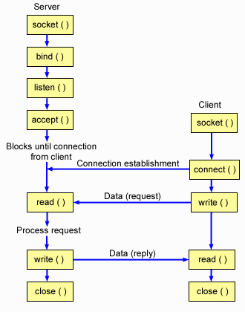
A TCP Server – Client Interaction

Slide 110
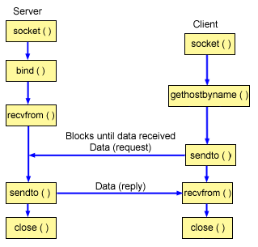
A UDP Server – Client Interaction

Slide 111
Data Structures
Let us now look at the data structures used
to hold all the address Information:
Struct sockaddr { unsigned short sa_family; char sa_data[14]; }
Struct sockaddr_in { short sin_family; unsigned short sin_port; // Port Number struct in_addr sin_addr; // IP Address char sin_zero[8]; }
Struct in_addr { unsigned long s_addr; // 4 bytes long }

Slide 112
Byte Ordering
Byte ordering is the attribute of a system which indicates whether integers are stored / represented left to right or right to left.
Example 1: short int x = 0xAABB (hex) This can be stored in memory as 2 adjacent bytes as either (0xaa , 0xbb) or as (0xbb, 0xaa). Big Endian: Byte Value : [0xAA] [0xBB] Memory : [ 0 ] [ 1 ] Little Endian: Byte Value : [0xBB] [0xAA] Memory : [ 0 ] [ 1 ]

Slide 113
Byte Ordering
Example 2: int x = 0xAABBCCDD This 4 byte long integer can be represented in the same 2 orderings: Big Endian: Byte Value: [0xAA] [0xBB] [0xCC] [0xDD] Memory: [ 0 ] [ 1 ] [ 2 ] [ 3 ] Little Endian: Byte Value: [0xDD] [0xCC] [0xBB] [0xAA] Memory: [ 0 ] [ 1 ] [ 2 ] [ 3 ]
All Network data is sent in Big Endian format.
In the networking world we call this representation as Network Byte Order and native representation on the host as Host Byte Order.
We convert all data into Network Byte Order before transmission.

Slide 114
Some utility functions :
Byte Ordering: Host Byte Order to Network Byte Order: htons() , htonl() Network Byte Order to Host Byte Order: ntohs() , ntohl()

Slide 115
syscalls()
We will now describe the following calls in detail :
Socket()
Bind()
Listen()
Accept()
Connect()
Read() / Send() / Sendto()
Write() / Recv() / Recvfrom()
Close()

Slide 116
Socket() – A Connection Endpoint
This creates an endpoint for a network connection. int socket(int doman, int type, int protocol) domain = AF_INET (IPv4 communication) type = SOCK_STREAM (TCP) , SOCK_DGRAM (UDP) protocol = 0 (for our discussion)
Example : socket(AF_INET, SOCK_STREAM, 0); This will create a TCP socket.
The call returns a socket descriptor on success and -1 on an error.

Slide 117
Bind() – Attaching to an IP and Port
A server process calls bind to attach itself to a specific port and IP address. int bind(int sockfd, struct sockaddr *my_addr, int sock_addrlen) sockfd = socket descriptor returned by socket() my_addr = pointer to a valid sockaddr_in structure cast as a sockaddr * pointer sock_addrlen = length of the sockaddr_in structure
Example : struct sockaddr_in my; bzero( (char *)&my, sizeof(my)) my.sin_family = AF_INET; my.sin_port = htons(80); my.sin_addr.s_addr =htonl( INADDR_ANY); bind(sock, (struct sockaddr *)&my, sizeof(my));

Slide 118
Listen() – Wait for a connection
The server process calls listen to tell the kernel to initialize a wait queue of connections for this socket. int listen(int sock, int backlog) sock = socket returned by socket() backlog = Maximum length of the pending connections queue
Example: Listen(sock, 10); This will allow a maximum of 10 connections to be in pending state.

Slide 119
Accept() – A new connection !
Accept is called by a Server process to accept new connections from new clients trying to connect to the server. Int Accept(int socket, (struct sockaddr *)&client, *client_len) socket = the socket in listen state client = will hold the new client’s information when accept returns client_len = pointer to size of the client structure
Example : struct sockaddr_in client; int len = sizeof(client); Accept(sock, (struct sockaddr *)&client, &len);

Slide 120
Connect() – connect to a service
Connect is called by a client to connect to a server port. int connect(int sock, (struct sockaddr *)&server_addr, socklen_t len) sock: a socket returned by socket() server_addr: a sockaddr_in struct pointer filled with all the remote server details and cast as a sockaddr struct pointer len: size of the server_addr struct
Example: connect(sock, (struct sockaddr *)server_addr, len);

Slide 121
Send / Recv
Send(), Recv() , Read() , Write() etc calls are used to send and receive data . Int send(int sock, void *mesg, size_t len, int flags) Int recv(int sock, void *mesg, size_t len, int flags) sock = A connected socket mesg = Pointer to a buffer to send/receive data from/in . len = Size of the message buffer flags = 0 (for our purpose) The return value is the number of bytes actually sent/received.
Example: char send_buffer[1024]; char recv_buffer[1024]; int sent_bytes; int recvd_bytes; sent_bytes = send(sock, send_buffer, 1024, 0); recvd_bytes = recv(sock, recv_buffer, 1024, 0);

Slide 122
Close()
Close signals the end of communication between a server-client pair. This effectively closes the socket. int close(int sock) sock = the socket to close
Example : close(sock);

Slide 123
SEND (DGRAM-style): int sendto(int sockfd, const void *msg, int len, int flags, const struct sockaddr *to, int tolen);
msg: message you want to send
len: length of the message
flags := 0
to: socket address of the remote process
tolen: = sizeof(struct sockaddr)
returned: the number of bytes actually sent
RECEIVE (DGRAM-style): int recvfrom(int sockfd, void *buf, int len, unsigned int flags, struct sockaddr *from, int *fromlen);
buf: buffer to receive the message
len: length of the buffer (“don’t give me more!”)
from: socket address of the process that sent the data
fromlen:= sizeof(struct sockaddr)
flags := 0
returned: the number of bytes received
CLOSE: close (socketfd);

Slide 124
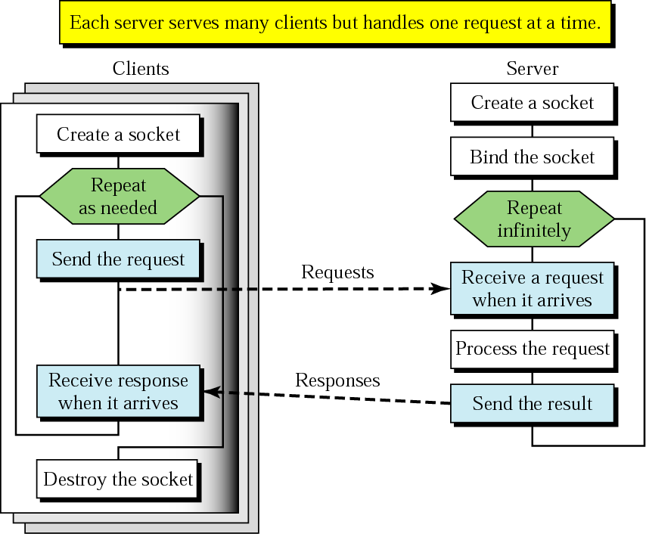
Client+server: connectionless
CREATE
BIND
SEND
RECEIVE
SEND
CLOSE

Slide 125
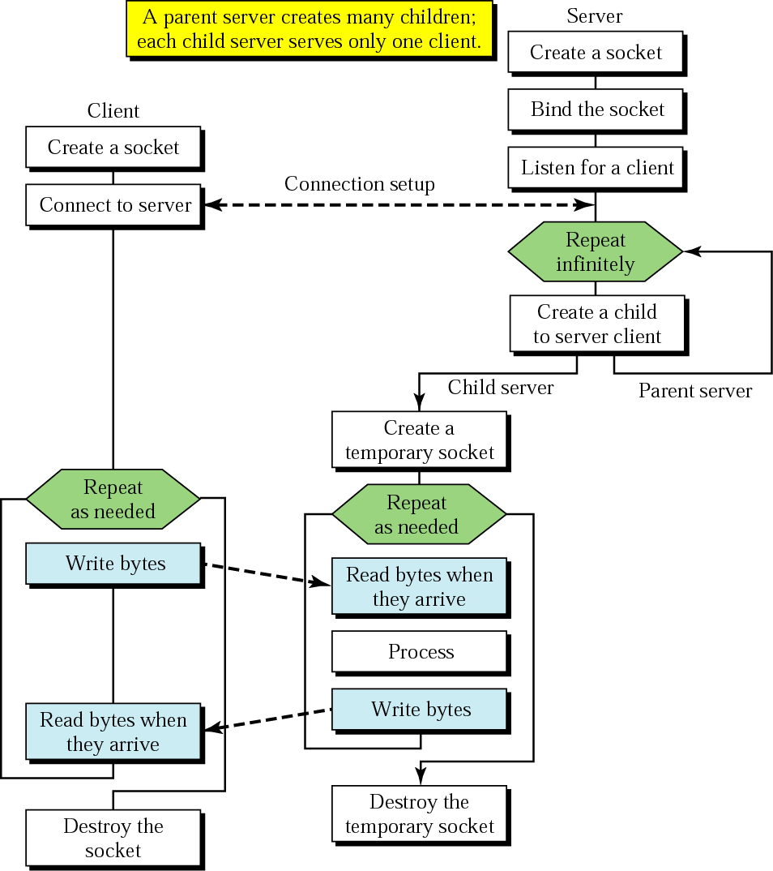
Client+server: connection-oriented
BIND
SOCKET
LISTEN
CONNECT
TCP three-way handshake
ACCEPT
SEND
RECEIVE
SEND
RECEIVE
CLOSE
Concurrent server

Slide 126
EchoClient.c – #include’s
#include <stdio.h> /* for printf() and fprintf() */
#include <sys/socket.h> /* for socket(), connect(),
sendto(), and recvfrom() */
#include <arpa/inet.h> /* for sockaddr_in and
inet_addr() */
#include <stdlib.h> /* for atoi() and exit() */
#include <string.h> /* for memset() */
#include <unistd.h> /* for close() */
#define ECHOMAX 255 /* Longest string to echo */

Slide 127
EchoClient.c -variable declarations
int main(int argc, char *argv[])
{
int sock; /* Socket descriptor */
struct sockaddr_in echoServAddr; /* Echo server address */
struct sockaddr_in fromAddr; /* Source address of echo */
unsigned short echoServPort =7; /* Echo server port */
unsigned int fromSize; /* address size for recvfrom() */
char *servIP=“172.24.23.4”; /* IP address of server */
char *echoString=“I hope this works”; /* String to send to echo server */
char echoBuffer[ECHOMAX+1]; /* Buffer for receiving echoed string */
int echoStringLen; /* Length of string to echo */
int respStringLen; /* Length of received response */

Slide 128
EchoClient.c - creating the socket and sending
/* Create a datagram/UDP socket */
sock = socket(AF_INET, SOCK_DGRAM, 0);
/* Construct the server address structure */
memset(&echoServAddr, 0, sizeof(echoServAddr)); /* Zero out structure */
echoServAddr.sin_family = AF_INET; /* Internet addr family */
echoServAddr.sin_addr.s_addr = htonl(servIP); /* Server IP address */
echoServAddr.sin_port = htons(echoServPort); /* Server port */
/* Send the string to the server */
sendto(sock, echoString, echoStringLen, 0, (struct sockaddr *) &echoServAddr, sizeof(echoServAddr);
/* Recv a response */

Slide 129
EchoClient.c – receiving and printing
fromSize = sizeof(fromAddr);
recvfrom(sock, echoBuffer, ECHOMAX, 0, (struct sockaddr *) &fromAddr, &fromSize);
/* Error checks like packet is received from the same server*/
/* null-terminate the received data */
echoBuffer[echoStringLen] = '\0';
printf("Received: %s\n", echoBuffer); /* Print the echoed arg */
close(sock);
exit(0);
} /* end of main () */

Slide 130
EchoServer.c
int main(int argc, char *argv[])
{
int sock; /* Socket */
struct sockaddr_in echoServAddr; /* Local address */
struct sockaddr_in echoClntAddr; /* Client address */
unsigned int cliAddrLen; /* Length of incoming message */
char echoBuffer[ECHOMAX]; /* Buffer for echo string */
unsigned short echoServPort =7; /* Server port */
int recvMsgSize; /* Size of received message */
/* Create socket for sending/receiving datagrams */
sock = socket(AF_INET, SOCK_DGRAM, 0);
/* Construct local address structure */
memset(&echoServAddr, 0, sizeof(echoServAddr)); /* Zero out structure */
echoServAddr.sin_family = AF_INET; /* Internet address family */
echoServAddr.sin_addr.s_addr = htonl(“172.24.23.4”);
echoServAddr.sin_port = htons(echoServPort); /* Local port */
/* Bind to the local address */
bind(sock, (struct sockaddr *) &echoServAddr, sizeof(echoServAddr);

Slide 131
for (;;) /* Run forever */
{
cliAddrLen = sizeof(echoClntAddr);
/* Block until receive message from a client */
recvMsgSize = recvfrom(sock, echoBuffer, ECHOMAX, 0,
(struct sockaddr *) &echoClntAddr, &cliAddrLen);
printf("Handling client %s\n", inet_ntoa(echoClntAddr.sin_addr));
/* Send received datagram back to the client */
sendto(sock, echoBuffer, recvMsgSize, 0,
(struct sockaddr *) &echoClntAddr, sizeof(echoClntAddr);
}
} /* end of main () */
Error handling is must

Slide 132
Assignment 1
Consider Two way communication between two processes using two pipes one in each direction. Explain what happens under following cases.
i) both the pipes are empty & both the processes are trying to read from their read end.
ii) Both the processes write to their o/p files continuously with out any attempt to read from the other end.
2. With a diagram describe the implementation of a server with multiple clients using FIFOS.(Note: give the details about no of FIFOS & its direction of usage & information exchange)
3. Implement following functions with semaphores.
To initialize the semaphore in a set to a user mentioned value
To check for a value 2 & if is equal or greater than 2 then decrement it.
To increment the value
(Note: give the values of structures used in semaphore operation)

